Slide 1
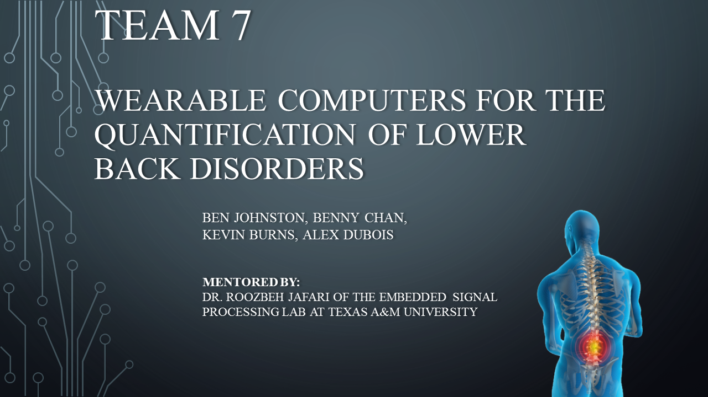
1

Slide 2
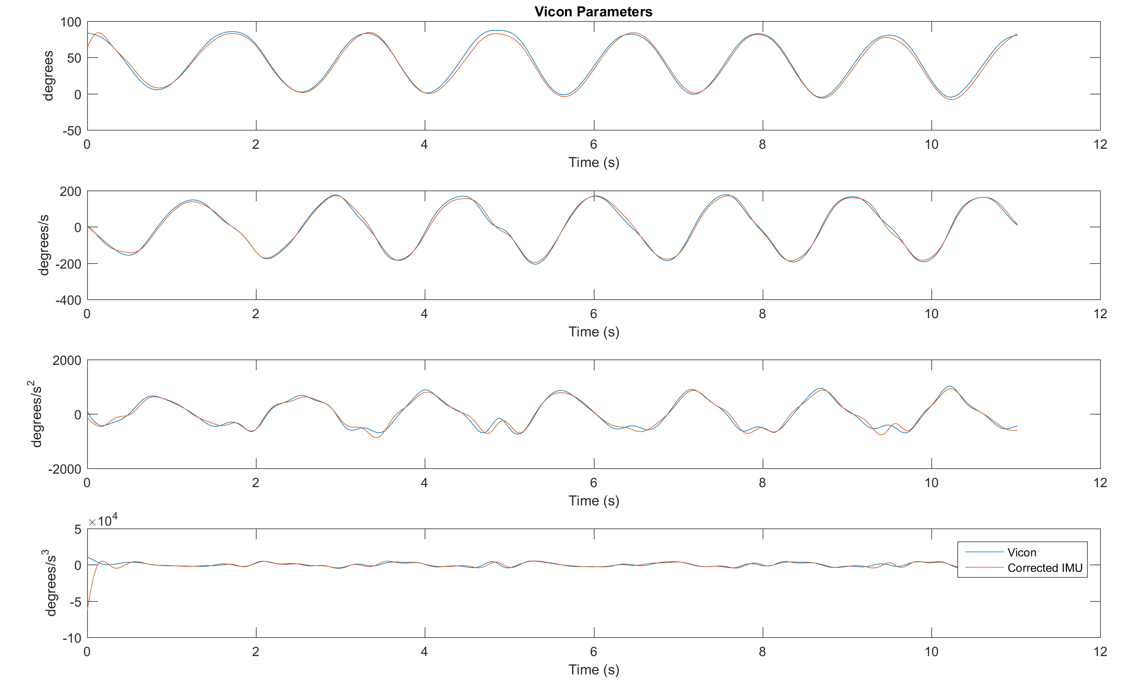
Trial One

Slide 3
Error and Maximums Trial 1
RMSE:
Position – 3.7053 degrees
Velocity – 9.6125 degrees/s
Acceleration – 83.6168 degrees/s^2
Jerk – 4624.7 degrees/s^3
Maximums:
Velocity – Vicon =226.6204 d/s | Fusion Signal = 196.1724 d/s
Acceleration– Vicon = 1024.7 d/s^2 | Fusion Signal = 931.17 d/s^2
Jerk– Vicon = 1.063e+4 d/s^3 | Fusion Signal = 6.254e+4 d/s^3

Slide 4
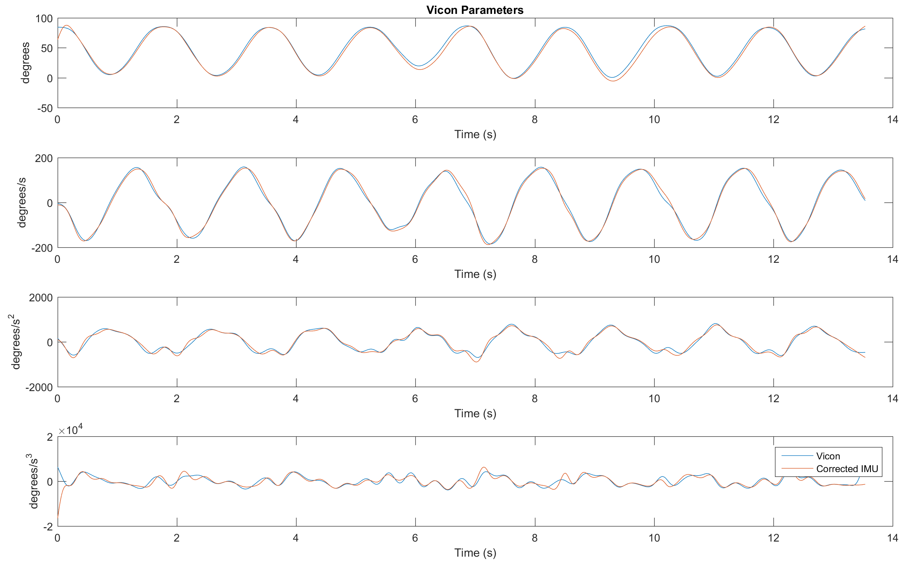
Trial Two

Slide 5
Error and Maximums Trial 2
RMSE:
Position – 3.9093 degrees
Velocity – 9.5863 degrees/s
Acceleration – 76.2641 degrees/s^2
Jerk – 1672.1 degrees/s^3
Maximums:
Velocity – Vicon =196.6514 d/s | Fusion Signal = 187.702 d/s
Acceleration– Vicon = 817.3 d/s^2 | Fusion Signal = 897.5 d/s^2
Jerk– Vicon = 1.099e+4 d/s^3 | Fusion Signal = 1.655e+4 d/s^3

Slide 6
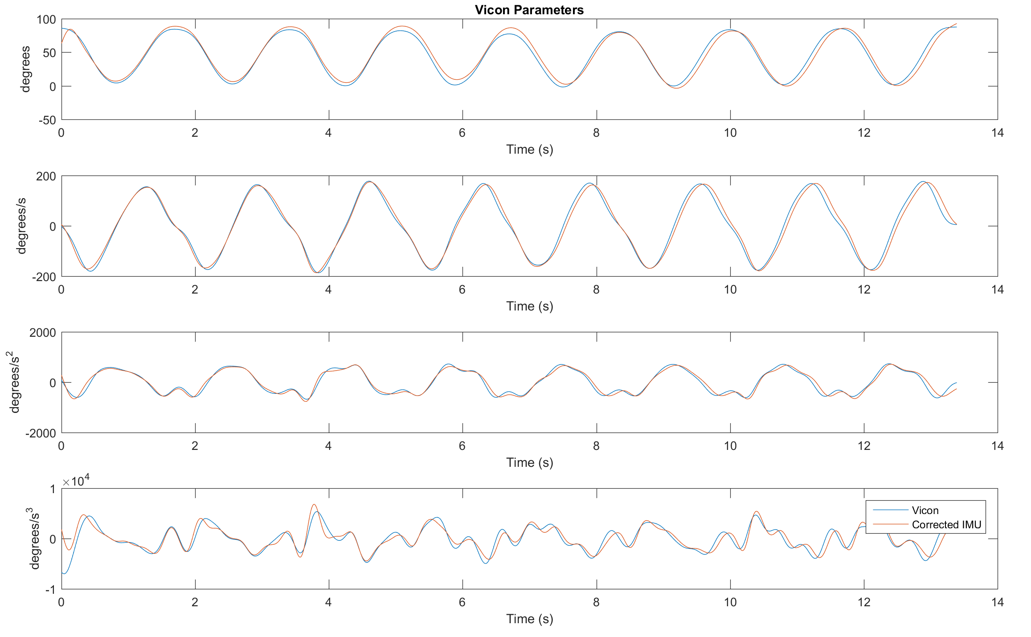
Trial Three

Slide 7
Error and Maximums Trial 3
RMSE:
Position – 5.7013 degrees
Velocity – 16.007 degrees/s
Acceleration – 90.896 degrees/s^2
Jerk – 1058.1 degrees/s^3
Maximums:
Velocity – Vicon =201.824 d/s | Fusion Signal = 186.255 d/s
Acceleration– Vicon = 733.21 d/s^2 | Fusion Signal = 765.95 d/s^2
Jerk– Vicon = 7.000e+3 d/s^3 | Fusion Signal = 6.811e+3 d/s^3

Slide 8
Averages Over Three Trials
Position RMSE: 4.3445 degrees
Velocity RMSE: 11.74 degrees/s
Acceleration RMSE: 83.6 degrees/s^2
Jerk RMSE: 2451.63 degrees/s^3
Maximum Velocity error %
Trial 1: 13.435 %
Trial 2: 4.55 %
Trial 3: 7.7 %
Average: 8.562 %

